Slide 1

agile scrum workflow

Slide 2
Objectives
To understand a simple Agile Scrum Workflow
Set up Trello
Create a simple workflow
Add User Stories to the Product Backlog

Slide 3
Simple Agile workflow
A simple agile workflow can consist of 4 columns
Product Backlog | Sprint Backlog | Doing | Done
User Story 3 | User Story 2 | User Story 7 | User Story 1
User Story 8 | User Story 5
User Story 6
User Story 4

Slide 4
The Product Backlog is a list of all features, enhancements and fixes to be made to the product in future releases
The feature in this list may need to have a priority, acceptance criteria providing The Definition of Ready State
Product backlog

Slide 5
The sprint backlog is the set of product backlog features selected for inclusion in the sprint
They are DoR (Definition of Ready) and have their acceptance criteria and any other information required.
The development team, scrum master and product owner have selected these features which they believe can be developed within the sprint timeframe
Sprint backlog

Slide 6
Doing
When a developer begins to work on a feature then that feature is moved to the Doing List

Slide 7
A feature is moved to the Done List when the feature is in a state of DoD (Definition of Done)
It has been developed
It has been tested
It has passed acceptance testing
It is ready to be included in an update to the application
Done LIST

Slide 8
Tello is a free Kanban board which can be used to create and apply your simple Agile Workflow
(or any workflow, even your own to-do lists)
Trello
Create a Workspace first and then add a Board
A Board can have many Cards
A Card can move between Lists (use drag-drop)
Board is either private or public
Public boards can be viewed by anyone but can only be edited by authorized members

Slide 9
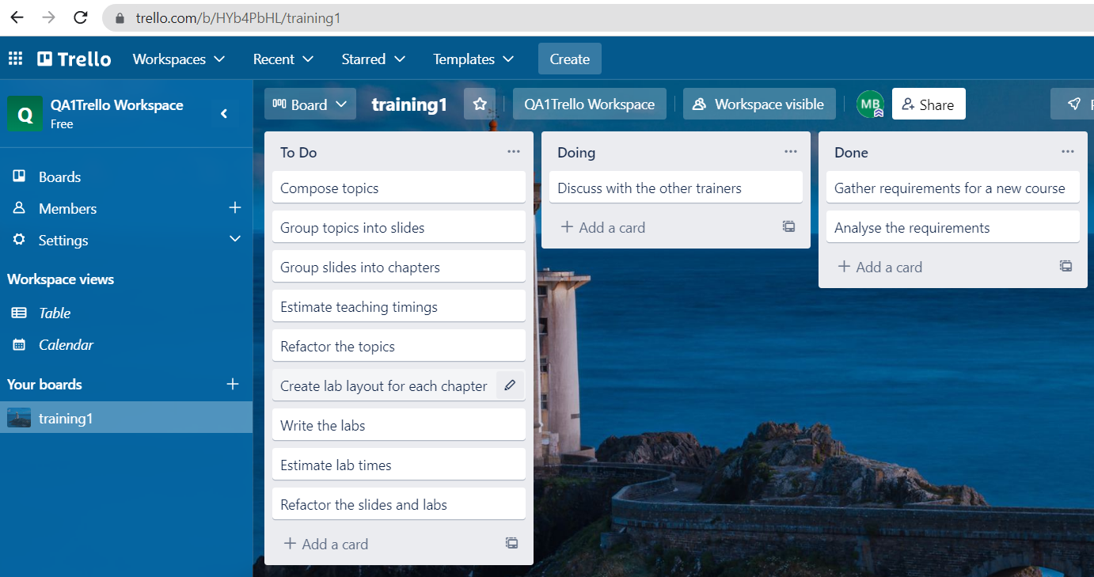
Edit

Slide 10
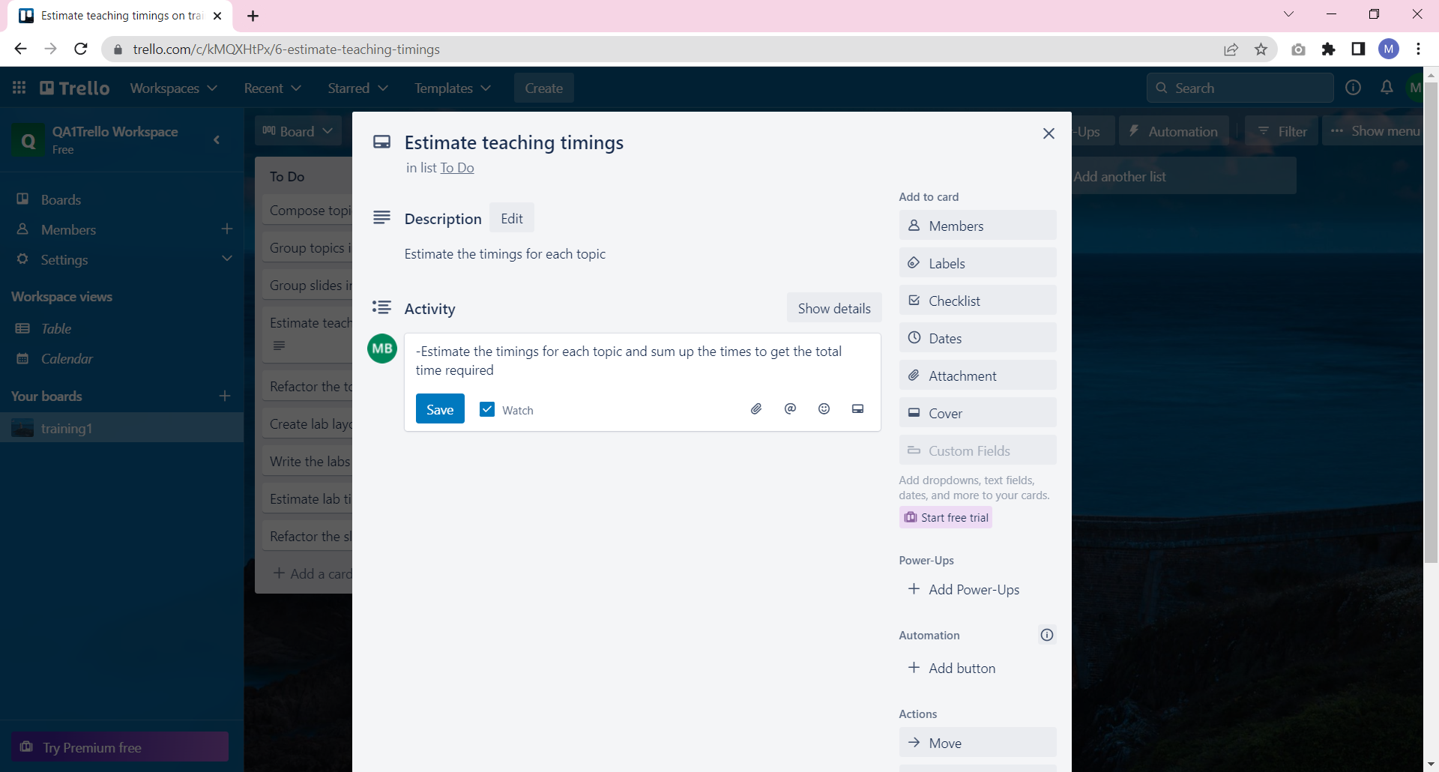

Slide 11

Review
You understand how to set up a simple Agile Scrum Workflow
Set up Trello
Create a simple workflow
Add User Stories to the Product Backlog

Slide 12
Lab
Complete Lab6.
Duration 40 minutes

